Slide 1
Press the F5 button on your keyboard to begin this tutorial.

Slide 2
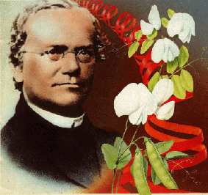
Genetics Tutorial
Start from beginning
Punnett Squares
The Adams’
The Davis’
Place your keyboard aside. Only use the mouse.

Slide 3
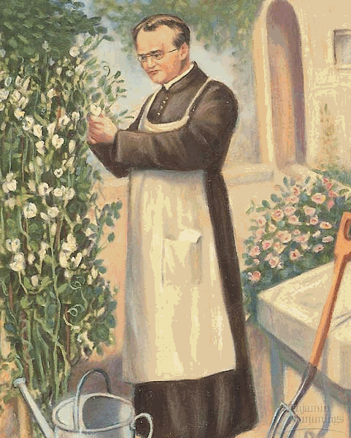
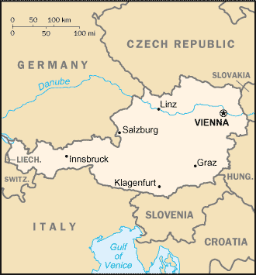
What is Genetics?
Back
Genetics is a branch of science that studies the patterns of heredity. This means that genetics tries to understand how traits are passed from parent to child. A better understanding of genetics and heredity will hopefully give those with genetic disorders a better quality of life as new medications and therapies can be designed to help treat illness.

Slide 4
What is Genetics?
Back
Genetics is a branch of science that studies the patterns of heredity. This means that genetics tries to understand how traits are passed from parent to child. A better understanding of genetics and heredity will hopefully give those with genetic disorders a better quality of life as new medications and therapies can be designed to help treat illness.
Genetics didn’t start with studying human illness. Genetics grew in roots…in the soil…with plants. Pea plants to be exact. Gregor Mendel was an Austrian monk who worked in the garden of a monastery . Over many years, he uncovered the basics of genetics and heredity.

Slide 5
Purple Flowers vs. White Flowers
Back
Parent Pea Plants (P Generation)
Mendel wanted to know what would happen when he mated (crossed) a pea plant with purple flower with a pea plant with white flowers. So using a brush, he rubbed pollen from 1 plant onto the other. This allowed them to exchange their genes.
Even though 1 parent had white flowers… 100% of the offspring were purple!
Baby Pea Plants (F1 Generation)

Slide 6
Purple Flowers vs. White Flowers
Back
Parent Pea Plants (P Generation)
Mendel wanted to know what would happen when he mated (crossed) a pea plant with purple flower with a pea plant with white flowers. So using a brush, he rubbed pollen from 1 plant onto the other. This allowed them to exchange their genes.
What happened to the gene for white? Even though every baby received a white gene, Mendel reasoned the purple gene was preventing the white gene from being expressed. Therefore the purple gene was called dominant. The hidden white gene was called recessive.
Baby Pea Plants (F1 Generation)

Slide 7
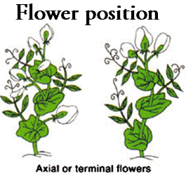
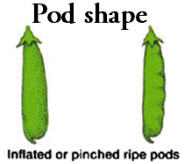
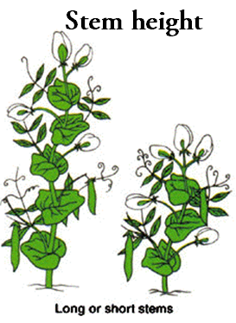
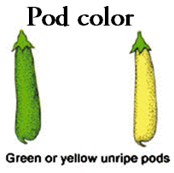
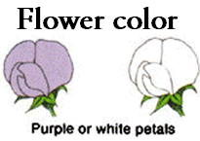
Back
Click me
Wrinkled seeds were often hidden
Terminal flowers were often hidden
Pinched pods were often hidden
Click me
Click me
Click me
Click me
Short stems were often hidden
Green seeds were often hidden
Click me
Click me
White flowers were often hidden
Yellow pods were often hidden
Mendel examined 7 traits during his pea plant experimentation. The seven traits are shown above. Strangely, he found that when he allowed the pea plants to reproduce, certain traits were hidden while others were expressed in the baby plants.
Click your mouse over the traits above to see which were most likely hidden.
So of course Mendel wanted to know why these traits were sometimes hidden.

Slide 8
The F1 Generation
Back
Mendel’s next step was to allow the newly created baby plants (F1 Generation) to reproduce with one another. I know…I know… he let brother and sister plants reproduce. Gross! But he reasoned that because they all had a white flowered parent, that maybe they still contained the instructions for white flowers.
Just like before, they passed their genes to the next generation. But unlike before, white baby plants were created! How could this be? After all, both parents were purple in color!
What percent of the pea plants were white?
Baby Pea Plants (F1 Generation)
No
No
No
No
0%
25%
50%
75%
100%
F2 Generation
Correct

Slide 9
3:1 Ratios
Back
3
1
Approximately 25% of the flowers had white petals. In the picture above, you can see a 3:1 ratio, which is the exact same thing as 25%. For every 3 purple flowers, we can expect 1 white flower.
Remember that Mendel examined 7 traits in total. Are you excited to see his other results?

Slide 10
More 3:1 Ratios?
Back
So what about the other 7 traits Mendel examined? From the table, you can see he counted thousands of pea plants. Remember that Mendel was trying to find a pattern for heredity.
Click the “question marks” to see the ratios he collected.
 | Dominant Trait | Recessive Trait | Ratio
Flower color | Purple 705 | White 224 | 3.15:1
Seed color | Yellow 6022 | Green 2001
Seed shape | Round 5474 | Wrinkled 1850
Pod color | Green 428 | Yellow 152
Pod shape | Round 882 | Constricted 299
Flower position | Axial 651 | Top 207
Plant height | Tall 787 | Dwarf 277
?

Slide 11
More 3:1 Ratios?
Back
So what about the other 7 traits Mendel examined? From the table, you can see he counted thousands of pea plants. Remember that Mendel was trying to find a pattern for heredity.
Click the “question marks” to see the ratios he collected.
 | Dominant Trait | Recessive Trait | Ratio
Flower color | Purple 705 | White 224 | 3.15:1
Seed color | Yellow 6022 | Green 2001 | 3.01:1
Seed shape | Round 5474 | Wrinkled 1850
Pod color | Green 428 | Yellow 152
Pod shape | Round 882 | Constricted 299
Flower position | Axial 651 | Top 207
Plant height | Tall 787 | Dwarf 277
About a 3:1 ratio
?

Slide 12
More 3:1 Ratios?
Back
So what about the other 7 traits Mendel examined? From the table, you can see he counted thousands of pea plants. Remember that Mendel was trying to find a pattern for heredity.
Click the “question marks” to see the ratios he collected.
 | Dominant Trait | Recessive Trait | Ratio
Flower color | Purple 705 | White 224 | 3.15:1
Seed color | Yellow 6022 | Green 2001 | 3.01:1
Seed shape | Round 5474 | Wrinkled 1850 | 2.96:1
Pod color | Green 428 | Yellow 152
Pod shape | Round 882 | Constricted 299
Flower position | Axial 651 | Top 207
Plant height | Tall 787 | Dwarf 277
About a 3:1 ratio
About a 3:1 ratio
?

Slide 13
More 3:1 Ratios?
Back
So what about the other 7 traits Mendel examined? From the table, you can see he counted thousands of pea plants. Remember that Mendel was trying to find a pattern for heredity.
Click the “question marks” to see the ratios he collected.
 | Dominant Trait | Recessive Trait | Ratio
Flower color | Purple 705 | White 224 | 3.15:1
Seed color | Yellow 6022 | Green 2001 | 3.01:1
Seed shape | Round 5474 | Wrinkled 1850 | 2.96:1
Pod color | Green 428 | Yellow 152 | 2.82:1
Pod shape | Round 882 | Constricted 299
Flower position | Axial 651 | Top 207
Plant height | Tall 787 | Dwarf 277
About a 3:1 ratio
About a 3:1 ratio
About a 3:1 ratio
?

Slide 14
More 3:1 Ratios?
Back
So what about the other 7 traits Mendel examined? From the table, you can see he counted thousands of pea plants. Remember that Mendel was trying to find a pattern for heredity.
Click the “question marks” to see the ratios he collected.
 | Dominant Trait | Recessive Trait | Ratio
Flower color | Purple 705 | White 224 | 3.15:1
Seed color | Yellow 6022 | Green 2001 | 3.01:1
Seed shape | Round 5474 | Wrinkled 1850 | 2.96:1
Pod color | Green 428 | Yellow 152 | 2.82:1
Pod shape | Round 882 | Constricted 299 | 2.95:1
Flower position | Axial 651 | Top 207
Plant height | Tall 787 | Dwarf 277
About a 3:1 ratio
About a 3:1 ratio
About a 3:1 ratio
About a 3:1 ratio
?

Slide 15
More 3:1 Ratios?
Back
So what about the other 7 traits Mendel examined? From the table, you can see he counted thousands of pea plants. Remember that Mendel was trying to find a pattern for heredity.
Click the “question marks” to see the ratios he collected.
 | Dominant Trait | Recessive Trait | Ratio
Flower color | Purple 705 | White 224 | 3.15:1
Seed color | Yellow 6022 | Green 2001 | 3.01:1
Seed shape | Round 5474 | Wrinkled 1850 | 2.96:1
Pod color | Green 428 | Yellow 152 | 2.82:1
Pod shape | Round 882 | Constricted 299 | 2.95:1
Flower position | Axial 651 | Top 207 | 3.14:1
Plant height | Tall 787 | Dwarf 277
About a 3:1 ratio
About a 3:1 ratio
About a 3:1 ratio
About a 3:1 ratio
About a 3:1 ratio
?

Slide 16
More 3:1 Ratios?
Back
So what about the other 7 traits Mendel examined? From the table, you can see he counted thousands of pea plants. Remember that Mendel was trying to find a pattern for heredity.
Click the “question marks” to see the ratios he collected.
 | Dominant Trait | Recessive Trait | Ratio
Flower color | Purple 705 | White 224 | 3.15:1
Seed color | Yellow 6022 | Green 2001 | 3.01:1
Seed shape | Round 5474 | Wrinkled 1850 | 2.96:1
Pod color | Green 428 | Yellow 152 | 2.82:1
Pod shape | Round 882 | Constricted 299 | 2.95:1
Flower position | Axial 651 | Top 207 | 3.14:1
Plant height | Tall 787 | Dwarf 277 | 2.84:1
About a 3:1 ratio
About a 3:1 ratio
About a 3:1 ratio
About a 3:1 ratio
About a 3:1 ratio
About a 3:1 ratio
?

Slide 17
More 3:1 Ratios?
Back
So what about the other 7 traits Mendel examined? From the table, you can see he counted thousands of pea plants. Remember that Mendel was trying to find a pattern for heredity.
Click the “question marks” to see the ratios he collected.
 | Dominant Trait | Recessive Trait | Ratio
Flower color | Purple 705 | White 224 | 3.15:1
Seed color | Yellow 6022 | Green 2001 | 3.01:1
Seed shape | Round 5474 | Wrinkled 1850 | 2.96:1
Pod color | Green 428 | Yellow 152 | 2.82:1
Pod shape | Round 882 | Constricted 299 | 2.95:1
Flower position | Axial 651 | Top 207 | 3.14:1
Plant height | Tall 787 | Dwarf 277 | 2.84:1
About a 3:1 ratio
About a 3:1 ratio
About a 3:1 ratio
About a 3:1 ratio
About a 3:1 ratio
About a 3:1 ratio
About a 3:1 ratio

Slide 18
More 3:1 Ratios?
Back
So what about the other 7 traits Mendel examined? From the table, you can see he counted thousands of pea plants. Remember that Mendel was trying to find a pattern for heredity.
Click the “question marks” to see the ratios he collected.
Even though it wasn’t perfect. We can see that every trait had about a 3:1 ratio of dominant to recessive features. If there were 3 yellow seeds for every 1 green seed, what percentage of plants had yellow seeds?
 | Dominant Trait | Recessive Trait | Ratio
Flower color | Purple 705 | White 224 | 3.15:1
Seed color | Yellow 6022 | Green 2001 | 3.01:1
Seed shape | Round 5474 | Wrinkled 1850 | 2.96:1
Pod color | Green 428 | Yellow 152 | 2.82:1
Pod shape | Round 882 | Constricted 299 | 2.95:1
Flower position | Axial 651 | Top 207 | 3.14:1
Plant height | Tall 787 | Dwarf 277 | 2.84:1
0%
No
25%
No
50%
No
75%
Correct
100%
No

Slide 19
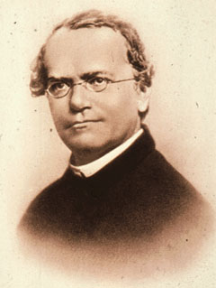
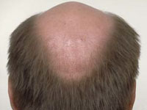
Coincidence?
Back
All 3:1 ratios! No way that is coincidence!
Male Pattern Baldness
Mendel was shocked to see that every recessive trait was expressed about 25% of the time and every dominant trait was expressed about 75% of the time. No way this can be coincidence!
Mendel’s conclusions changed science and the world forever. He concluded that 1 form of a gene can hide another form of a gene. For example, the purple form of a gene would hide the white form of a gene. This now explained why some traits and diseases would skip generations.
Click to see examples of traits that can skip generations

Slide 20
Coincidence?
Back
All 3:1 ratios! No way that is coincidence!
Male Pattern Baldness
Mendel was shocked to see that every recessive trait was expressed about 25% of the time and every dominant trait was expressed about 75% of the time. No way this can be coincidence!
Mendel’s conclusions changed science and the world forever. He concluded that 1 form of a gene can hide another form of a gene. For example, the purple form of a gene would hide the white form of a gene. This now explained why some traits and diseases would skip generations.

Slide 21
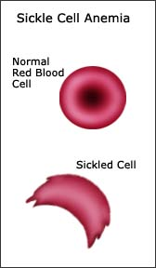
Coincidence?
Back
All 3:1 ratios! No way that is coincidence!
Sickle Cell Anemia
Mendel was shocked to see that every recessive trait was expressed about 25% of the time and every dominant trait was expressed about 75% of the time. No way this can be coincidence!
Mendel’s conclusions changed science and the world forever. He concluded that 1 form of a gene can hide another form of a gene. For example, the purple form of a gene would hide the white form of a gene. This now explained why some traits and diseases would skip generations.

Slide 22
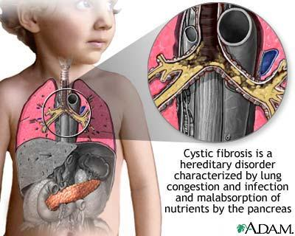
Coincidence?
Back
All 3:1 ratios! No way that is coincidence!
Cystic fibrosis
Mendel was shocked to see that every recessive trait was expressed about 25% of the time and every dominant trait was expressed about 75% of the time. No way this can be coincidence!
Mendel’s conclusions changed science and the world forever. He concluded that 1 form of a gene can hide another form of a gene. For example, the purple form of a gene would hide the white form of a gene. This now explained why some traits and diseases would skip generations.

Slide 23
Coincidence?
Back
All 3:1 ratios! No way that is coincidence!
Cystic fibrosis
Mendel was shocked to see that every recessive trait was expressed about 25% of the time and every dominant trait was expressed about 75% of the time. No way this can be coincidence!
Mendel’s conclusions changed science and the world forever. He concluded that 1 form of a gene can hide another form of a gene. For example, the purple form of a gene would hide the white form of a gene. This now explained why some traits and diseases would skip generations.
Even though Mendel didn’t know it yet. His work would later be used to help predict and treat illnesses.

Slide 24
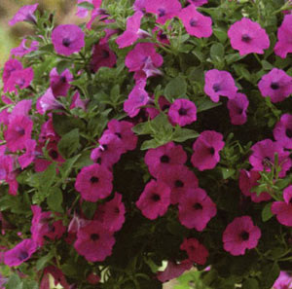
The Genetics
Back
P
P
P
p
p
p
The gene for flower color has two varieties: purple and white. These alternative forms of a gene are called alleles. The purple flower has two alleles that determine it's flower color. One allele came from each parent. We use capital letters to abbreviate the two dominant alleles (PP).
The white flower has two alleles that determine it's flower color. One allele came from each parent. We use lowercase letters to abbreviate the two recessive alleles (pp). When these two plants reproduced, they contributed one of their alleles to each baby flower.
Purple is dominant so it hides the instructions for white flower.
What just happened? Each parent gave 1 allele to it’s babies. The purple plant gave a purple allele and the white plant gave a white allele. But which color is dominant?
purple
white
Because white was hidden, it is recessive

Slide 25
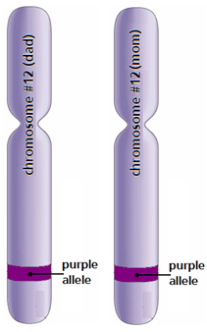
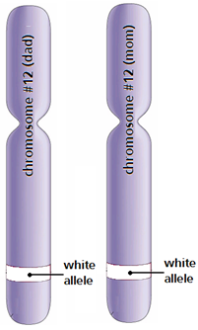
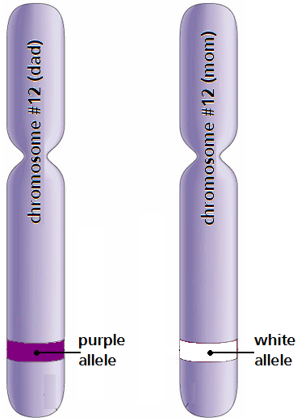
Genotypes?
Back
Click the picture
P
P
p
p
P
p
Purple is dominant to white. And that is important to remember.
These are chromosomes above. Remember we have two of every chromosome (one from mom…one from dad.) The actual allele combination that an organism contains is called it's genotype. Organisms have one of the three possible combinations you see above. Click on the chromosomes above to see their names.

Slide 26
Genotypes?
Back
Click the picture
Two dominant alleles is called Homozygous Dominant.
P
P
p
p
P
p
Purple is dominant to white. And that is important to remember.
These are chromosomes above. Remember we have two of every chromosome (one from mom…one from dad.) The actual allele combination that an organism contains is called it's genotype. Organisms have one of the three possible combinations you see above. Click on the chromosomes above to see their names.

Slide 27
Genotypes?
Back
Click the
picture
Two recessive alleles is called Homozygous Recessive.
Two dominant alleles is called Homozygous Dominant.
P
P
p
p
P
p
Purple is dominant to white. And that is important to remember.
These are chromosomes above. Remember we have two of every chromosome (one from mom…one from dad.) The actual allele combination that an organism contains is called it's genotype. Organisms have one of the three possible combinations you see above. Click on the chromosomes above to see their names.

Slide 28
Genotypes?
Back
One dominant & one recessive allele is called Heterozygous.
Two recessive alleles is called Homozygous Recessive.
Two dominant alleles is called Homozygous Dominant.
P
P
p
p
P
p
Purple is dominant to white. And that is important to remember.
These are chromosomes above. Remember we have two of every chromosome (one from mom…one from dad.) The actual allele combination that an organism contains is called it's genotype. Organisms have one of the three possible combinations you see above. Click on the chromosomes above to see their names.

Slide 29
Genotypes?
Back
One dominant & one recessive allele is called Heterozygous.
Two recessive alleles is called Homozygous Recessive.
Two dominant alleles is called Homozygous Dominant.
P
P
p
p
P
p
Purple is dominant to white. And that is important to remember.
These are chromosomes above. Remember we have two of every chromosome (one from mom…one from dad.) The actual allele combination that an organism contains is called it's genotype. Organisms have one of the three possible combinations you see above. Click on the chromosomes above to see their names.
Remember that the F1 generation was created from a purple parent (PP) and a white parent (pp), but all the babies were purple (Pp) in color. What do you think was the genotype of the F1 generation?
What is Pp called?
What is Pp called?
Correct
Homozygous dominant
Homozygous recessive
Heterozygous

Slide 30
The F1 Answers
Back
P
P
P
P
p
p
p
p
dominant
dominant
dominant
dominant
This is why Mendel found that 100% of the F1 generation was purple in color. Every baby flower received a copy of the dominant purple allele (P) and also a copy of the recessive white allele (p). But because purple was dominant, the color white was hidden. Every baby flower had a gene combination (genotype) of Pp .
So why the 3 purple:1 white ratio in the F2 generation? Let’s see more closely.

Slide 31
Why 25% White?
back
P
P
P
P
p
p
Remember that Mendel allowed the F1 generation reproduce with one another. Because of this, he unknowingly brought back the color white. Here’s how. There are 4 possible ways for alleles to combine during reproduction. Here they are.
Homozygous dominant

Slide 32
Why 25% White?
back
P
P
P
p
p
p
Remember that Mendel allowed the F1 generation reproduce with one another. Because of this, he unknowingly brought back the color white. Here’s how. There are 4 possible ways for alleles to combine during reproduction. Here they are.
Homozygous dominant
Heterozygous
PP

Slide 33
Why 25% White?
back
P
P
p
P
p
p
Remember that Mendel allowed the F1 generation reproduce with one another. Because of this, he unknowingly brought back the color white. Here’s how. There are 4 possible ways for alleles to combine during reproduction. Here they are.
Homozygous dominant
Heterozygous
Heterozygous
PP
Pp

Slide 34
Why 25% White?
back
P
P
p
p
p
p
Remember that Mendel allowed the F1 generation reproduce with one another. Because of this, he unknowingly brought back the color white. Here’s how. There are 4 possible ways for alleles to combine during reproduction. Here they are.
Homozygous dominant
Heterozygous
Heterozygous
Homozygous recessive
PP
Pp
pP

Slide 35
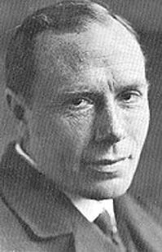
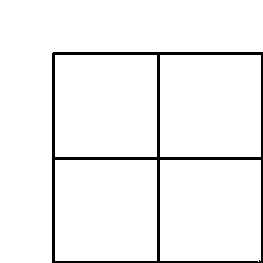
Punnett Squares
Back
Reginald Punnett created a mathematics tool called a Punnett square to help solve genetics problems. Punnett squares help scientists to predict genetic combinations from simple traits such as flower color to serious disorders such as cystic fibrosis. By predicting genetic disorders, information can be given to families who have a history of genetic illnesses. This will allow the family to make informed, educated decisions about the future health of their child or children. So let’s see how to create them…

Slide 36
Mendel and Punnett Squares
Back
Reginald Punnett used the information gained by Mendel to create charts to help predict probabilities. Let’s examine the data Mendel collected for pea plant height. Tall was dominant (T) and short was recessive (t).
Let’s examine Mendel’s F1 generation using a Punnett square. Mendel crossed two heterozygous Tall (Tt) plants with one another.

Slide 37
Mendel’s Punnett squares
Back
Pea plant #1
Pea Plant #2
T
t
T
t
T
t
T
T
t
T
t
t
1st step: Place the genotypes of each parent on the outside of the Punnett square.
2nd step: Fill in the Punnett squares. Click the play buttons to proceed.
NEXT

Slide 38
Determining the Phenotypes
Back
T
t
Key:
T = dominant tall growth
t = recessive short growth
T
T
T
t
T
click
Homozygous dominant
Tall growth
click
Heterozygous
Tall growth
T
t
t
t
t
Heterozygous
Tall growth
Homozygous recessive
Short growth
click
click
Each square represents 1 of the 4 gene combinations possible when parents reproduce. Click on the inside of the 4 Punnett squares to see the descriptions.
Remember that Mendel had a 3:1 ratio of tall plants to short plants. What is the probability of growing short plants?
NEXT
0%
25%
50%
75%
100%
Correct
Look again
Look again
Look again
Look again

Slide 39
Determining the Phenotypes
Back
T
t
Key:
T = dominant tall growth
t = recessive short growth
T
T
T
t
T
Homozygous dominant
Tall growth
Heterozygous
Tall growth
T
t
t
t
t
Heterozygous
Tall growth
Homozygous recessive
Short growth
Each square represents 1 of the 4 possible gene combinations possible when parents reproduce. Click on the inside of the 4 Punnett squares to see the descriptions.
Good job…But we can use this information to predict more than pea traits too. Let’s use Mendel’s and Punnett’s work to help people who have genetic problems.

Slide 40
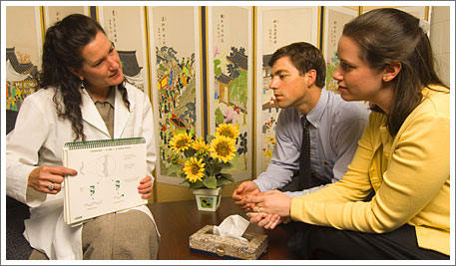
Can you help the Adams’?
Back
Mr. and Mrs. Adams need your help, so they came to see you for guidance. They both have a history of cystic fibrosis in their families, but they do not physically have the disease themselves. After testing, you have found them to be heterozygous/carriers of cystic fibrosis. This means they have each have a healthy allele (H) on one of their chromosome #7s and a defective allele (h) on their other chromosome #7.
Time to make a Punnett square…

Slide 41
Helping the Adams family
Back
Mr. Adams’ genotype
Mrs. Adams’ genotype
H
H
h
h
H
h
H
H
h
H
h
h
H = healthy
h = cystic fibrosis
1st step: Place the genotypes of each parent on the outside of the Punnett square.
2nd step: Fill in the Punnett squares. Click the play buttons to proceed.
NEXT

Slide 42
Determining the Phenotypes
Back
H
h
Key:
H = dominant healthy
h = recessive cystic fibrosis
H
H
H
h
H
Homozygous
dominant healthy
Heterozygous healthy/
Carrier of C.F.
click
click
H
h
h
h
h
click
Heterozygous healthy/
Carrier of C.F.
click
Homozygous recessive
cystic fibrosis
Each square represents 1 of the 4 possible gene combinations possible when parents reproduce. Click on the inside of the 4 Punnett squares to see the descriptions.
If the Adams’ decide to have a child, what is the probability they have a child with cystic fibrosis?
Correct
Look again
Look again
Look again
Look again
0%
25%
50%
75%
100%

Slide 43
Determining the Phenotypes
Back
H
h
Key:
H = dominant healthy
h = recessive cystic fibrosis
H
H
H
h
H
Homozygous
dominant healthy
Heterozygous healthy/
Carrier of C.F.
H
h
h
h
h
Heterozygous healthy/
Carrier of C.F.
Homozygous recessive
cystic fibrosis
Each square represents 1 of the 4 possible gene combinations possible when parents reproduce. Click on the inside of the 4 Punnett squares to see the descriptions.
If the Adams’ decide to have a child, what is the probability they have a healthy child?
Look again
Correct
Look again
Look again
Look again
0%
25%
50%
75%
100%

Slide 44
Determining the Phenotypes
Back
H
h
Key:
H = dominant healthy
h = recessive cystic fibrosis
H
H
H
h
H
Homozygous
dominant healthy
Heterozygous healthy/
Carrier of C.F.
H
h
h
h
h
Heterozygous healthy/
Carrier of C.F.
Homozygous recessive
cystic fibrosis
Each square represents 1 of the 4 possible gene combinations possible when parents reproduce. Click on the inside of the 4 Punnett squares to see the descriptions.
If the Adams’ decide to have a child, what is the probability they have a heterozygous child?
Correct
Look again
Look again
Look again
Look again
0%
25%
50%
75%
100%

Slide 45
Back
We were hoping to have 3 children total. What are the chances that all three children have cystic fibrosis?
There is a 25% chance each child you have will be born with C.F.
¼ x ¼ x ¼ = ?
Each child separately has a 25% chance of being born with C.F. But one child will not affect the others. To calculate the odds that all three children will have C.F. is really easy. Just multiply the individual odds together. What is the probability that all 3 children will have cystic fibrosis?
Multiply 4x4x4 in the denominators. Try again.
Multiply 4x4x4 in the denominators. Try again.
The odds are small. But not that small.
You added, but you need to multiply.
Correct
0%
3/4
3/12
1/12
1/64

Slide 46
A tough decision
Back
So if you do have 3 children, there is only a 1/64 chance that all three will have C.F.
“You have a very important decision to make. Currently, sufferers of C.F. usually live to their early to mid-30s before they pass away. The disease causes too much damage to their lungs and heart. And they will require regular therapy throughout their lives so you will need to be prepared to help at any time. There are no mental problems associated with this disorder, only physical. But now that you know the risk, you must weigh the consequences before making your decisions to start a family of your own, adopt, or have no children at all. I wish you the best of luck.”
One more family to help

Slide 47
Can you help the Davis’?
Back
Good afternoon Mr. and Mrs. Davis.
How can I help you today?
Mr. Davis suffers from sickle cell disease, which leaves him with shortness of breath and pain in his joints. Mrs. Davis is healthy, but she is a heterozygous/carrier of sickle cell disease because her mother passed the allele onto her. They are concerned about their future children. Can you help?
Let’s do another Punnett square…

Slide 48
Helping the Davis family
Back
Mr. Davis’ genotype
Mrs. Davis’ genotype
h
h
h
h
h
h
H
H
h
H
h
h
H = healthy
h = sickle cell disease
1st step: Place the genotypes of each parent on the outside of the Punnett square.
2nd step: Fill in the Punnett squares. Click the play buttons to proceed.
NEXT

Slide 49
Determining the Phenotypes
Back
h
h
Key:
H = dominant healthy
h = recessive sickle cell
H
h
H
h
H
click
Heterozygous healthy/
Carrier of sickle cell
click
Heterozygous healthy/
Carrier of sickle cell
h
h
h
h
h
click
click
Homozygous recessive
Sickle cell disease
Homozygous recessive
Sickle cell disease
Each square represents 1 of the 4 possible gene combinations possible when parents reproduce. Click on the inside of the 4 Punnett squares to see the descriptions.
If the Davis’ decide to have a child, what is the probability they have a child with sickle cell disease?
Correct
Look again
Look again
Look again
Look again
0%
25%
50%
75%
100%

Slide 50
Determining the Phenotypes
Back
h
h
Key:
H = dominant healthy
h = recessive sickle cell
H
h
H
h
H
Heterozygous healthy/
Carrier of sickle cell
Heterozygous healthy/
Carrier of sickle cell
h
h
h
h
h
Homozygous recessive
Sickle cell disease
Homozygous recessive
Sickle cell disease
Each square represents 1 of the 4 possible gene combinations possible when parents reproduce. Click on the inside of the 4 Punnett squares to see the descriptions.
If the Davis’ decide to have a child, what is the probability they have a homozygous dominant child ?
Look again
Look again
Look again
Correct
Look again
0%
25%
50%
75%
100%

Slide 51
Determining the Phenotypes
Back
h
h
Key:
H = dominant healthy
h = recessive sickle cell
H
h
H
h
H
Heterozygous healthy/
Carrier of sickle cell
Heterozygous healthy/
Carrier of sickle cell
h
h
h
h
h
Homozygous recessive
Sickle cell disease
Homozygous recessive
Sickle cell disease
Each square represents 1 of the 4 possible gene combinations possible when parents reproduce. Click on the inside of the 4 Punnett squares to see the descriptions.
If the Davis’ decide to have a child, what is the probability they have a healthy child ?
Correct
Look again
Look again
Look again
Look again
0%
25%
50%
75%
100%

Slide 52
Another tough decision…
Back
There is a 50/50 chance that every child will have sickle cell disease.
“You need to know that every child you have together will have a 50% chance of inheriting sickle cell disease. Life expectancy is shortened, with studies reporting an average life expectancy of 42 and 48 years for males and females, respectively. You need to know these facts before you decide how to proceed with your family. I wish you the best of luck if you decide to start a family.”

Slide 53
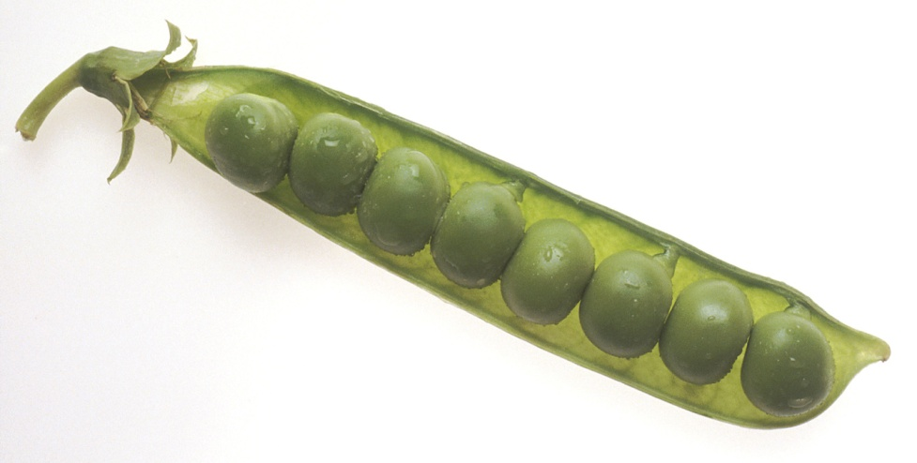
Remembering Mendel
Back
Wow! I can’t believe my work is helping families. Science is amazing!
Between 1856 and 1863 Mendel cultivated and tested some 29,000 pea plants. Mendel died on January 6, 1884, at age 61, in Brünn, Austria-Hungary (now Brno, Czech Republic). The significance of Mendel's work was not recognized until the turn of the 20th century. Its rediscovery prompted the foundation of the discipline of genetics.

Slide 54
The F1 Generation
In the picture you can see one white flower, out of a total of 4 flowers. I think you should try again.
1 white
4 total
Try again

Slide 55
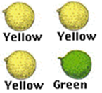
More 3:1 Ratios?
 | Dominant Trait | Recessive Trait | Ratio
Flower color | Purple 705 | White 224 | 3.15:1
Seed color | Yellow 6022 | Green 2001 | 3.01:1
Seed shape | Round 5474 | Wrinkled 1850 | 2.96:1
Pod color | Green 428 | Yellow 152 | 2.82:1
Pod shape | Round 882 | Constricted 299 | 2.95:1
Flower position | Axial 651 | Top 207 | 3.14:1
Plant height | Tall 787 | Dwarf 277 | 2.84:1
Check out the picture above.

Slide 56
More 3:1 Ratios?
 | Dominant Trait | Recessive Trait | Ratio
Flower color | Purple 705 | White 224 | 3.15:1
Seed color | Yellow 6022 | Green 2001 | 3.01:1
Seed shape | Round 5474 | Wrinkled 1850 | 2.96:1
Pod color | Green 428 | Yellow 152 | 2.82:1
Pod shape | Round 882 | Constricted 299 | 2.95:1
Flower position | Axial 651 | Top 207 | 3.14:1
Plant height | Tall 787 | Dwarf 277 | 2.84:1
Check out the picture above.
For every 3 yellow peas, Mendel only grew one green pea. That means 3 out of 4 peas were yellow.
I think you should try again to determine the percentage of yellow.

